Slide 1
Introduction to Hardware & the UNIX Command Line Interface
Dr. Emily Hill
Fall 2014
Notes:
How did we like code.org?

Slide 2
How does a computer work? Introduction to computer hardware
When programming a computer, it helps to have a basic understanding of the underlying hardware. Where do variables get stored? Where are functions or loops executed? How does all the data get converted into 0s & 1s?
Notes:
Bring in machine?

Slide 3
Encoding Information
There are 10 types of people in the world: those that understand binary, and those who don’t
Notes:
In a few minutes, you will be among those that do

Slide 4
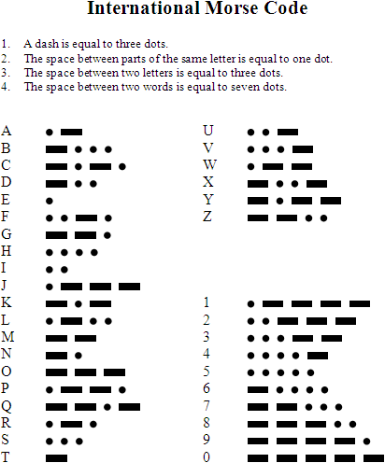
Encoding: Morse Code
http://en.wikipedia.org/wiki/Morse-code
http://en.wikipedia.org/wiki/SOS

Slide 5

Computer Encoding
How does a computer encode information?
Using 0s and 1s (bits)
1 bit can convey 2 pieces of information:
1 or 0
true or false
on or off
left or right

Slide 6
Exploring Bits
Raise your left hand for true, right hand for false:
8 / 2 = 4
How many pieces of information can be conveyed with 2 arms?
Multiple choice: the capital of NJ is… Left arm Right arm
New York Up Down
Princeton Down Up
Trenton Up Up
Montclair Down Down
Notes:
Left = right to me
Both arms should be up

Slide 7
Exploring Bits
Raise your left hand for true, right hand for false:
8 / 2 = 4
How many pieces of information can be conveyed with 2 arms?
Multiple choice: the capital of NJ is… Left arm Right arm
New York 1 0
Princeton 0 1
Trenton 1 1
Montclair 0 0
How many pieces of information can be conveyed with 2 arms?
Notes:
Left = right to me
Both arms should be up
4 pieces (2 bits) of information

Slide 8
Binary Numbers
Digital information is represented and stored in memory using the binary number system (as opposed to decimal)
A single binary digit (0 or 1) is called a bit
Devices that store and move information are cheaper and more reliable if they have to represent only two states
A single bit can represent two possible states, like a light bulb that is either on (1) or off (0)
Permutations of bits are used to store values
2 arms = 2 bits (up/down) = 4 possible combinations (permutations) = 4 pieces (bits) of information
Notes:
How many pieces of information (permutations) can you communicate with 1 hand (5 fingers)?

Slide 9
Bit Permutations
# Permutations (pieces of information):
2
4
8
16
1 bit
2 bits
3 bits
4 bits
0
1
00
01
10
11
000
001
010
011
100
101
110
111
0000
0001
0010
0011
0100
0101
0110
0111
1000
1001
1010
1011
1100
1101
1110
1111
Each additional bit doubles the number of possible permutations
How many pieces of information (permutations) can you communicate with 1 hand (5 fingers)?
Notes:
5 bits = 32 permutations

Slide 10
Bit Permutations
Each permutation can represent a particular item
There are 2^{N} permutations of N bits
Therefore, N bits are needed to represent 2^{N} unique items
1 bit ?
2 bits ?
3 bits ?
4 bits ?
5 bits ?
2¹ = 2 items
How many
items can be
represented by
2² = 4 items
2³ = 8 items
2⁴ = 16 items
2⁵ = 32 items

Slide 11
Bit Permutations
How many fingers do you need to represent the alphabet (26 letters)?
How much information can be encoded using 2 hands (10 fingers)?
6 bits ?
7 bits ?
8 bits ?
9 bits ?
10 bits ?
2⁶ = 64 items
How many
items can be
represented by
2⁷ = 128 items
2⁸ = 256 items
2⁹ = 512 items
2¹⁰ = 1024 items
Notes:
5
1024

Slide 12
Quick Check
How many bits would you need to represent each of the 50 United States using a unique permutation of bits?
000000 Alabama
000001 Alaska
000010 Arizona
000011 Arkansas
000100 California
000101 Colorado
etc.
Five bits wouldn't be enough, because 2⁵ = 32.
Six bits would give us 64 permutations, and some wouldn't be used.

Slide 13
Digital Information
Computers store all information digitally as bits:
numbers
text
graphics and images
audio
video
program instructions
In some way, all information is digitized - broken down into pieces and represented as numbers (which are encoded as bits)

Slide 14
Representing Text Digitally
For example, every character is stored as a number, including spaces, digits, and punctuation
Corresponding upper and lower case letters are separate characters
H i , H e a t h e r .
72 105 44 32 72 101 97 116 104 101 114 46

Slide 15
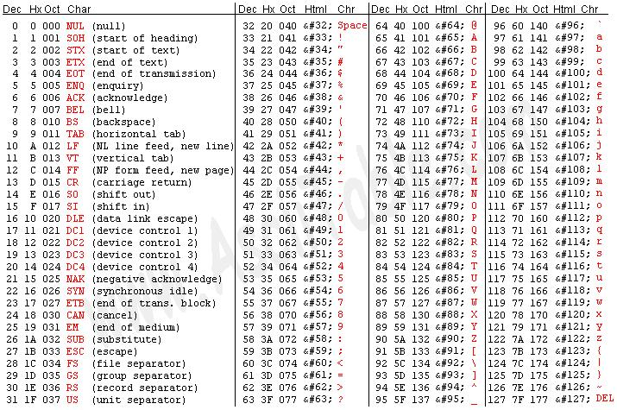
ASCII
www.asciitable.com

Slide 16
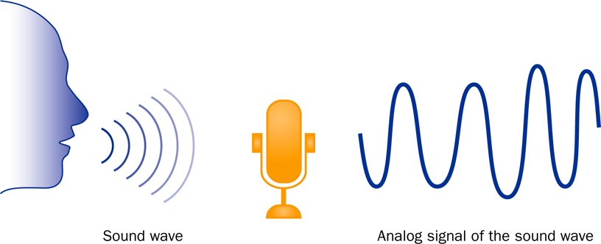
Analog Information
continuous, in direct proportion to the data represented
music on a record album - a needle rides on ridges in the grooves that are directly proportional to the voltages sent to the speaker

Slide 17
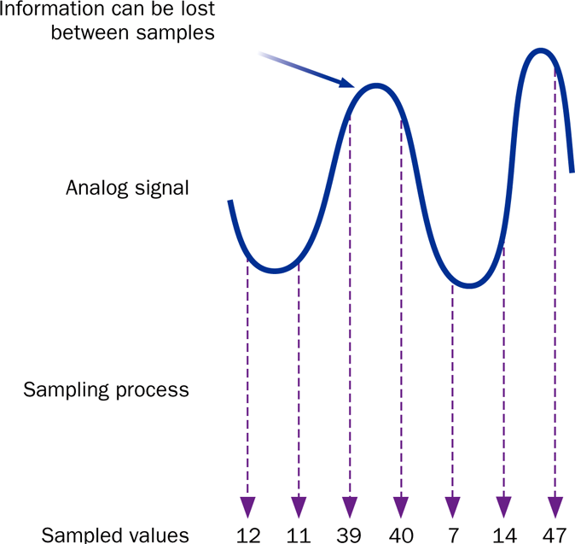
Sampling
sampling – used to digitize analog information like audio & video
music on a CD - the disc stores numbers representing specific voltage levels sampled at specific times

Slide 18
Storing Bits in Memory
We’ve got all these bits to store information in memory, but how do we access them?
How does the postman know where we live?
Computers use addresses to organize main memory & other storage devices
Bits typically grouped into sets of 8, called a byte

Slide 19
There are 10 types of people in the world: those that understand binary, and those who don’t
How many types of people are there?

Slide 20
Computer Hardware Components

Slide 21
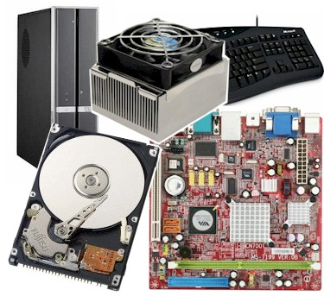

Slide 22
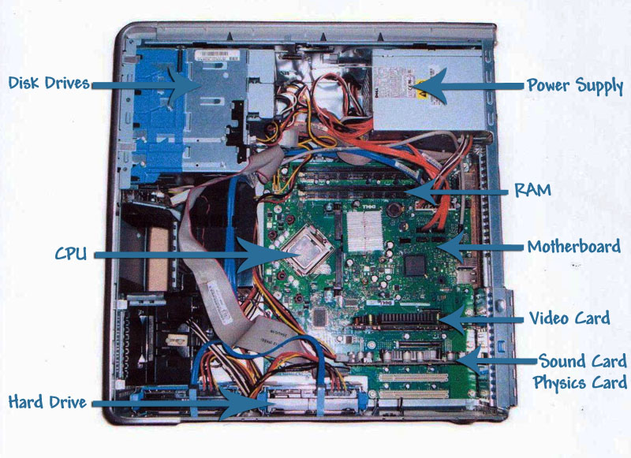

Slide 23
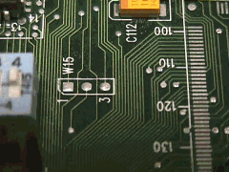
Motherboard
Houses the computer components
Connects them via a bus:
Notes:
What do all the components do?

Slide 24
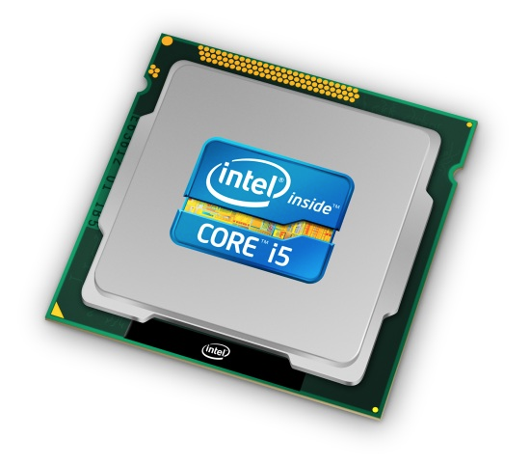
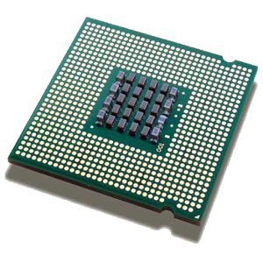
Processor (aka CPU)
Executes program instructions
e.g., performs arithmetic, runs loops

Slide 25
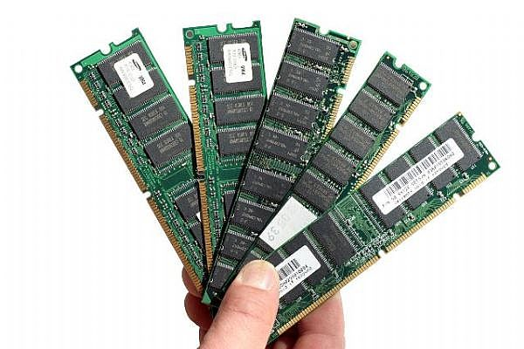
Memory
Stores data & program instructions while programs execute
E.g., stores variables and lists
Volatile: contents lost when computer turned off

Slide 26
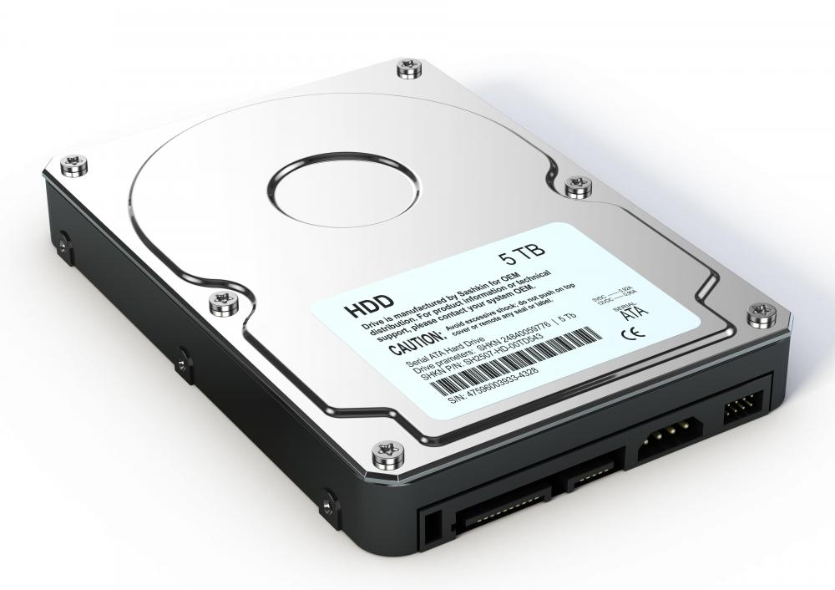
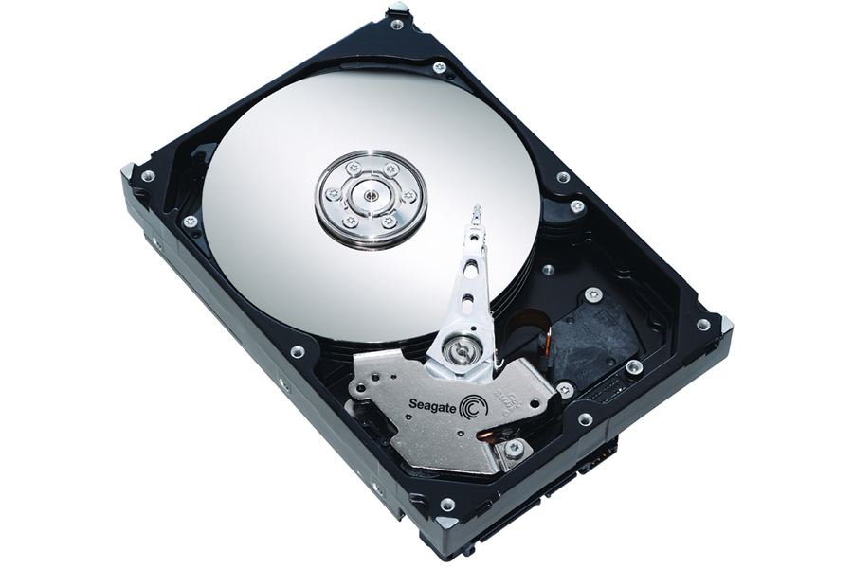
Hard drive
Non-volatile: contents persist (saved) even when computer turned off
Stores data and programs when not running

Slide 27



What is UNIX?
A well-known operating system that is one of the oldest and still widely used
Developed at AT&T Bell Labs during the 1970s right here in Murray Hill, NJ
Major functionality re-implemented as open source Linux
Today there are many “flavors”
Notes:
http://www.unix.org/what_is_unix/history_timeline.html

Slide 28
Why UNIX?
Most expert computer scientists know how to use the UNIX command line
Why?
Because it comes with a powerful set of programs to quickly automate tasks with little programming
Why doesn’t everyone use it?
Because command line interfaces (CLIs) are not as intuitive as graphical user interfaces (GUIs). However, UNIX is widely used & there is plenty of online help.

Slide 29
My UNIX Experience
Motivation: All the best programmers & hackers I’ve known are proficient in UNIX
To feel like a “real” computer scientist I wanted to learn how to harness this power for myself
In grad school worked on a Linux machine daily in a lab with more experienced students
I asked how they did some cool things
They patiently answered my noob questions
Research projects all relied on UNIX

Slide 30
In this class, we’ll use UNIX to develop our python programs.

Slide 31
DEMO TIME

Slide 32
Basic UNIX commands
ls: directory listing
pwd: present working directory
cd: change directory
cat: display (i.e., concatenate) to the screen
rm: remove
cp: copy
man: manual page
touch: create an empty file
.: current directory
..: parent directory
[tab]: autocomplete
[↑]: previously entered command
Notes:
demo

Slide 33
Homework
See google classroom site for links:
Finish HW3: Exploring Hardware & UNIX
Read Chapter 2 in “Think Python”
Bring laptop next class!
Notes:
Most HWs will get check/check+

